Slide 1


Statistics for Experimental Verification
MAE 106 – 04/25/2018

Slide 2
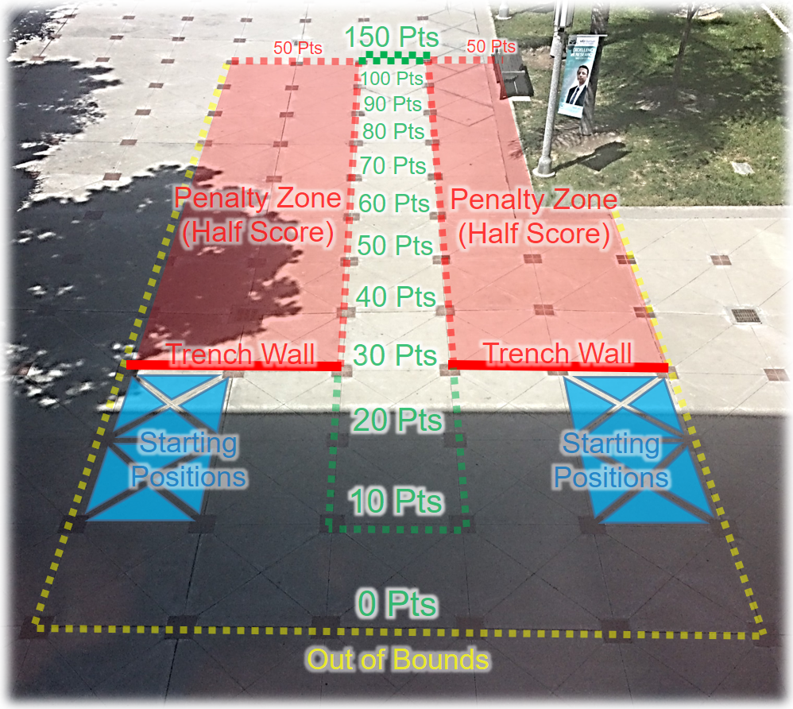
In the real world, engineering measurements are almost always stochastic
“Stochastic” = having some random variation
Example:
  In the final competition, the score your robot achieves will vary somewhat randomly from run to run because of:
    Noise in the sensors
    Unevenness in the pavement
    Collisions with other students
    Etc.
Statistics gives us techniques for:
  Describing the average behavior, and the variation in the behavior
    “Descriptive Statistics” – Mean, Standard Deviation
  Determining whether changing parameters make a significant difference in performance
    “Hypothesis Testing” – e.g. Student’s t-test

Slide 3
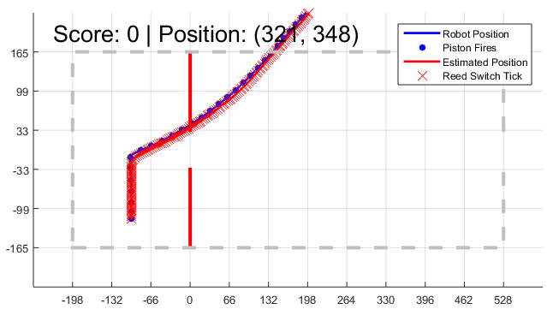
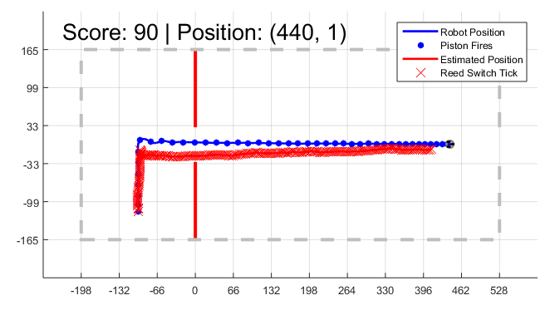
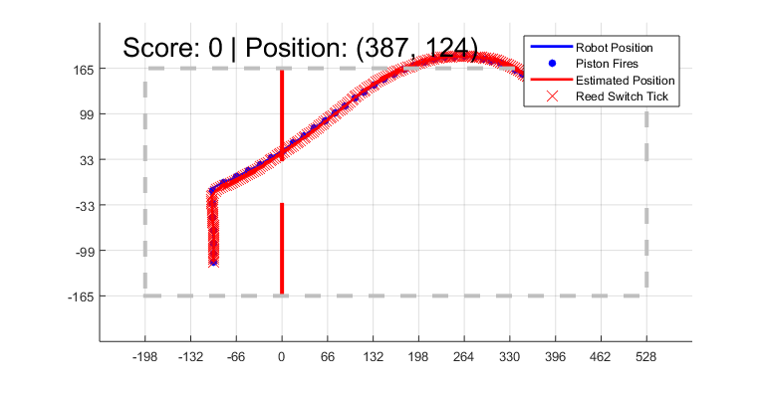
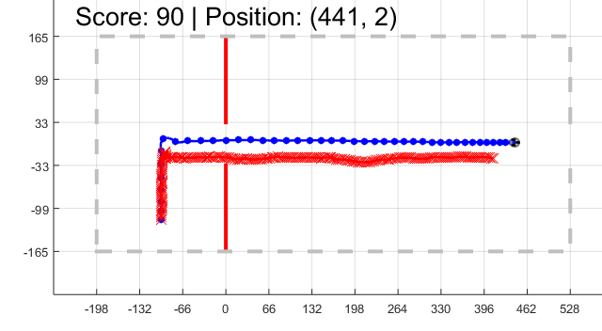
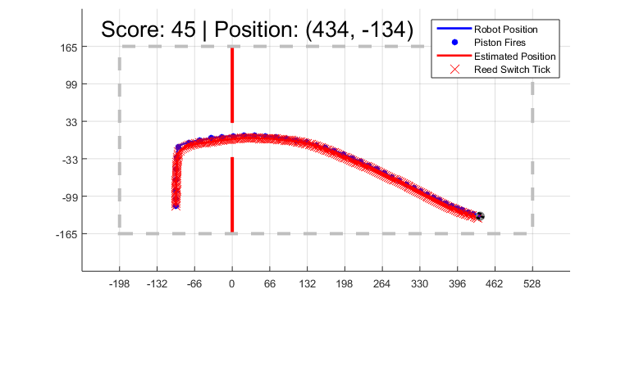
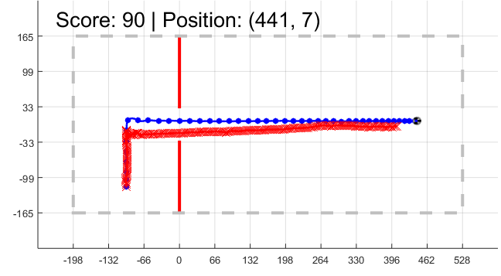
Examples from final project robot simulator
1 - Open-loop control
uses number of ticks to decide when to
% start turning, and time to decide when to stop turning.
2 - Hybrid control
uses ticks to decide when to start turning, and
% time to decide when to stop turning. After that, it uses the
% magnetometer to try to keep the correct direction

Slide 4
Note: What do we mean by open-loop and closed-loop control?
Open loop control – the output has no influence on the control action
  Just pump the piston N times, no matter where you actually are
  Just turn for 0.5 seconds, no matter if you’re headed in the right direction
Closed loop control – the output has an influence on the control action
  Use the Reed Switch to count the number of times the wheel actually turns to determine when to turn
  Use the Magnetometer to check if you’re heading in the right direction, and make steering adjustments based on your error
Hybrid control
  For our project, we define this as using open-loop control on propulsion and closed-loop control on steering

Slide 5
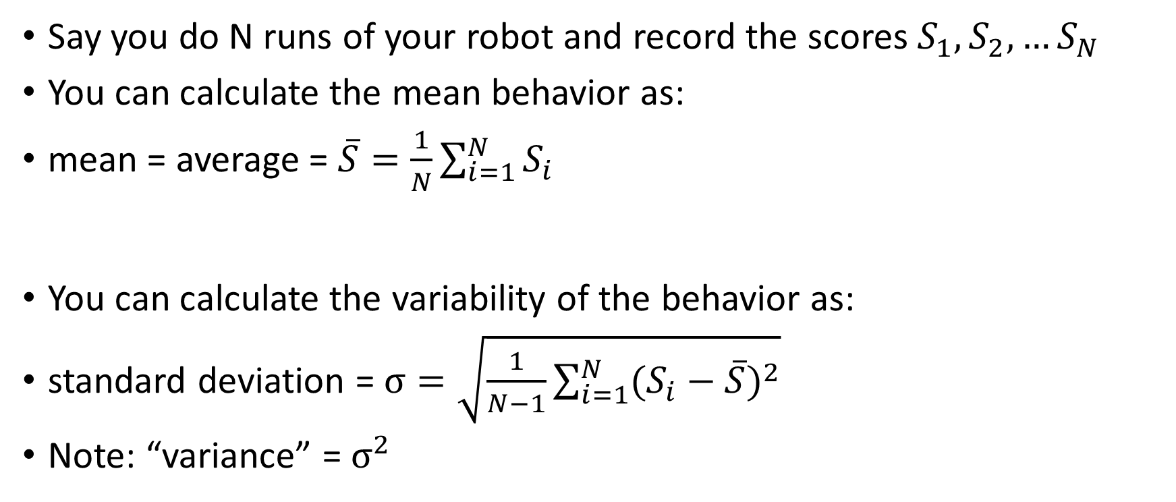
How do engineers typically summarize the behavior?
Say you do N runs of your robot and record the scores $S_{1},S_{2},…S_{N}$
You can calculate the mean behavior as:
mean = average = $\overline{S}=\frac{1}{N}\sum_{i=1}^{N}{S_{i}}$
You can calculate the variability of the behavior as:
standard deviation = $σ=\sqrt{\frac{1}{N−1}\sum_{i=1}^{N}{{(S_{i}−\overline{S})}^{2}}}$
Note: “variance” = $σ^{2}$

Slide 6
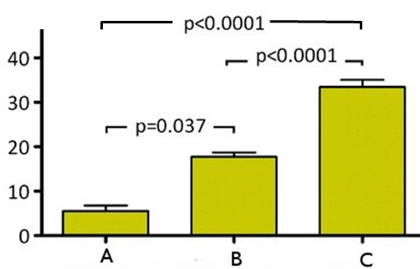
What’s a common way to plot mean and standard deviation?

Slide 7
How do we use statistics to determine whether changing the controller made a significant difference in your score? – Hypothesis testing
Use a “t-test”
This is a function in Excel and Matlab that takes in your two samples then returns the probability (p) that the two samples came from the same probability distribution
Widely accepted rule of thumb – p < 0.05 means the two samples are different

Slide 8
Example using
Excel
Run | Open loop score | Hybrid score
1 | 0 | 70
2 | 20 | 90
3 | 10 | 80
4 | 40 | 60
5 | 30 | 90
6 | 0 | 90
7 | 0 | 100
8 | 0 | 110
9 | 30 | 60
10 | 50 | 70
11 | 40 | 70
12 | 60 | 90
13 | 0 | 80
14 | 0 | 60
15 | 10 | 90
16 | 0 | 90
17 | 10 | 100
18 | 20 | 110
19 | 10 | 60
20 | 40 | 70
mean | 18.5 | 82.0 | p-value | 1.27E-13
std | 18.8 | 16.0
=TTEST(C2:C21,D2:D21,2,2)
=AVERAGE(C2:C21)
=STDEV(C2:C22)

Slide 9
Matlab
>> help ttest2
ttest2 Two-sample t-test with pooled or unpooled variance estimate.
H = ttest2(X,Y) performs a t-test of the hypothesis that two
independent samples, in the vectors X and Y, come from distributions
with equal means, and returns the result of the test in H. H=0
indicates that the null hypothesis ("means are equal") cannot be
rejected at the 5% significance level. H=1 indicates that the null
hypothesis can be rejected at the 5% level. The data are assumed to
come from normal distributions with unknown, but equal, variances. X
and Y can have different lengths.
This function performs an unpaired two-sample t-test. For a paired
test, use the TTEST function.
X and Y can also be matrices or N-D arrays. For matrices, ttest2
performs separate t-tests along each column, and returns a vector of
results. X and Y must have the same number of columns. For N-D
arrays, ttest2 works along the first non-singleton dimension. X and Y
must have the same size along all the remaining dimensions.
ttest2 treats NaNs as missing values, and ignores them.
[H,P] = ttest2(...) returns the p-value, i.e., the probability of
observing the given result, or one more extreme, by chance if the null
hypothesis is true. Small values of P cast doubt on the validity of
the null hypothesis.
[H,P,CI] = ttest2(...) returns a 100*(1-ALPHA)% confidence interval for
the true difference of population means.
[H,P,CI,STATS] = ttest2(...) returns a structure with the following fields:
'tstat' -- the value of the test statistic
'df' -- the degrees of freedom of the test
'sd' -- the pooled estimate of the population standard deviation
(for the equal variance case) or a vector containing the
unpooled estimates of the population standard deviations
(for the unequal variance case)

Slide 10
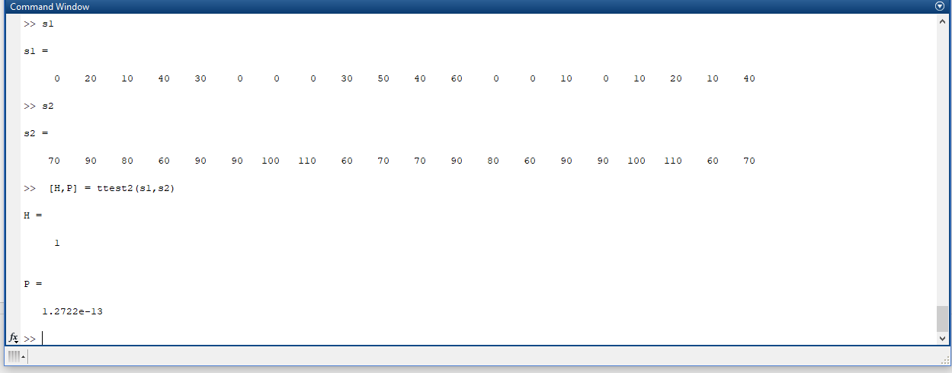
Matlab

Slide 11
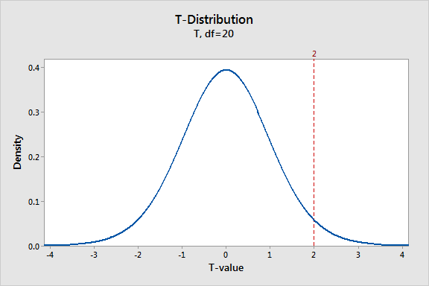
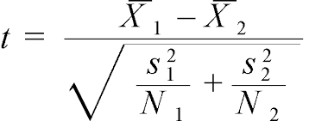
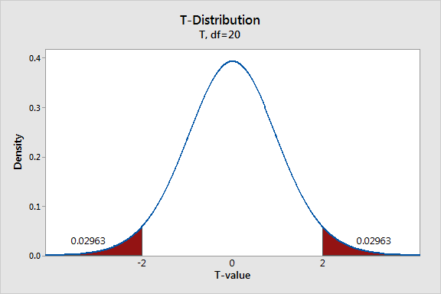
What’s the idea behind a t-test?
The t-statistic was introduced in 1908 by William Sealy Gosset, a chemist working for the Guinness brewery in Dublin, Ireland. "Student" was his pen name
“Null Hypothesis” – The mean of data from condition A is the same as the mean of data from condition B
T-Statistic:
Here X1 and X2 are the means, s1,s2 = standard deviation, N1 and N2 sample size
The t-statistic can be proven to follow the t-distribution, which is a probability distribution
That is, if we do our experiments over and over again, and plot a histogram of the t-statistic say for 1000 experiments, it will look like the t-distribution
When we do a t-test, we are checking how unlikely it is that the means from our experiment come from the same probability distribution

