Slide 1


Introduction to Arduinos

Slide 2
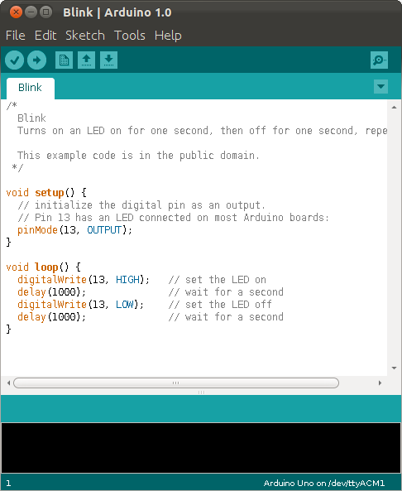
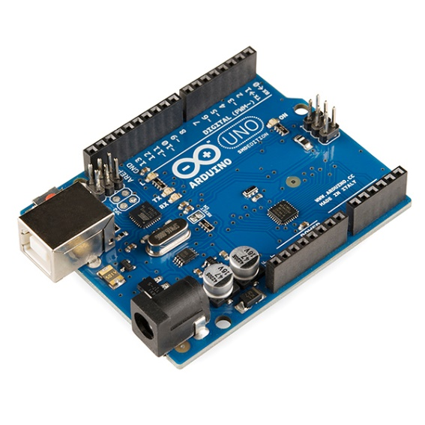
What is an Arduino?
Arduino is an electronics platform based on easy-to-use hardware (including a microcontroller) and software (based on C/C++).
“Arduino boards are able to read inputs - light on a sensor, a finger on a button, or a Twitter message - and turn it into an output - activating a motor, turning on an LED, publishing something online.
You tell your board what to do by sending a set of instructions to the microcontroller on the board.

Slide 3
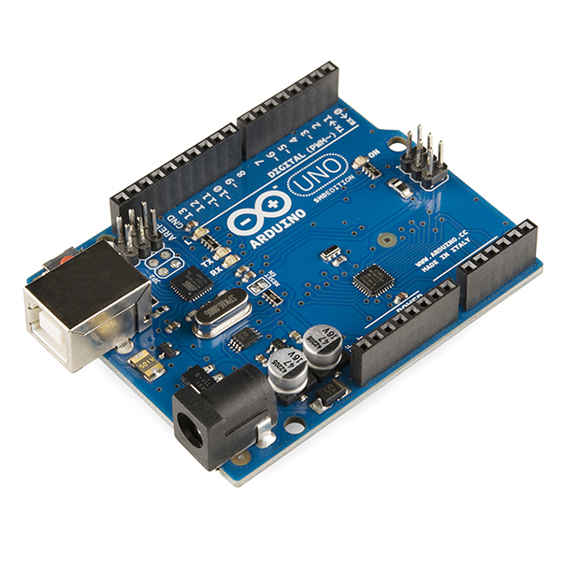
Arduino board and IDE

Slide 4
Why are Arduinos so popular?
Easy-to-use and well-supported
  Inexpensive ($20)
  Simple and accessible user experience
  Do not require extra hardware to program and use the microcontroller
  Wide variety of C/C++ functions that work with all the “Arduino family”
  Open-source
  Huge amount of online documentation (projects, samples, etc)
    e.g. https://lifehacker.com/top-10-kickass-arduino-projects-1747407543
  Large amount of “shields” that you can add on to do more things
    e.g. https://playground.arduino.cc/Main/SimilarBoards/

Slide 5
How/when will we use Arduinos in the lab?
ALL the labs in MAE106 use Arduino
Some of the code will be provided to you, but in most cases you will have to understand and change it accordingly to finish your lab and collect data for the write-ups

Slide 6
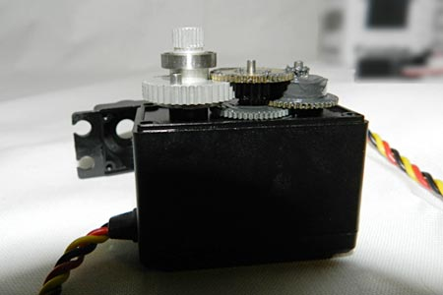
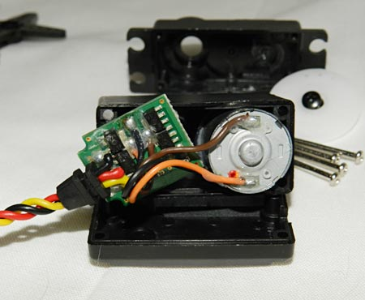
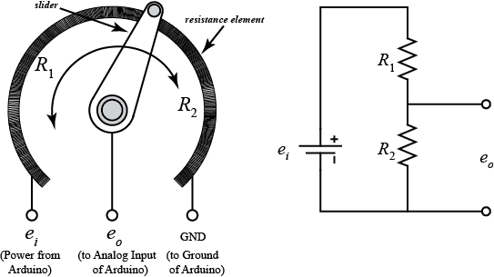
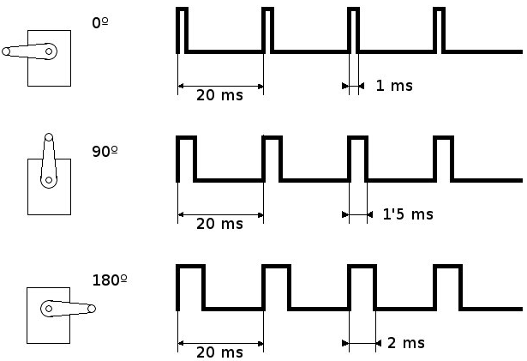
Example
Potentiometer:
Servomotor:
Arduino:
#include <Servo.h>
Servo myservo;
void setup()
{
myservo.attach(9);
}

Slide 7
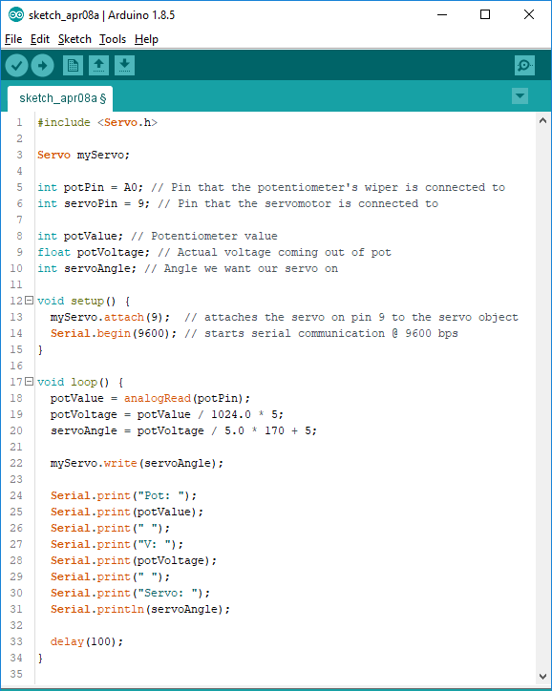
Example, continued
Potentiometer:

Slide 8

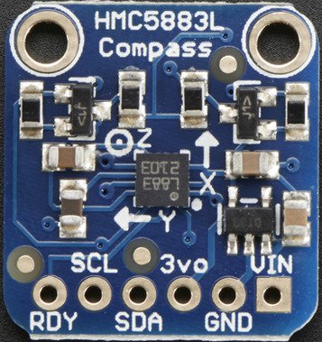
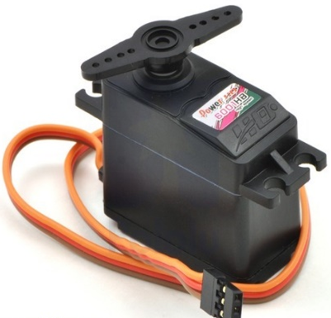
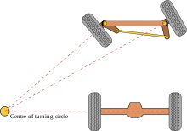
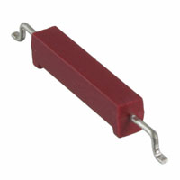
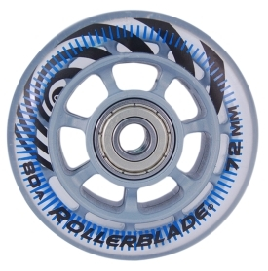
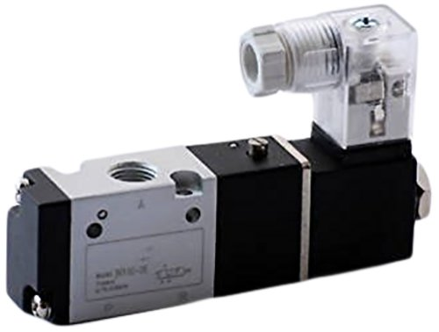
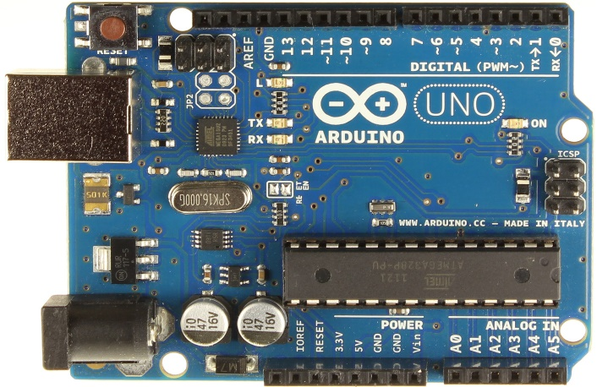
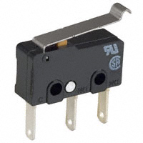
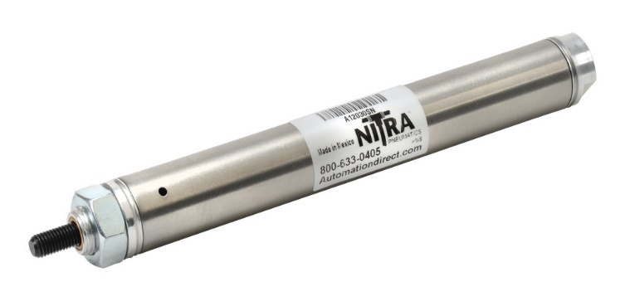
How the Arduino is used in our final project?
Built-in timer
Compass
Servo Motor
Steering Mechanism
Reed Switches
Solenoid Valve
Switches
(for optional whiskers)
Pneumatic Cylinder
Arduino

Slide 9
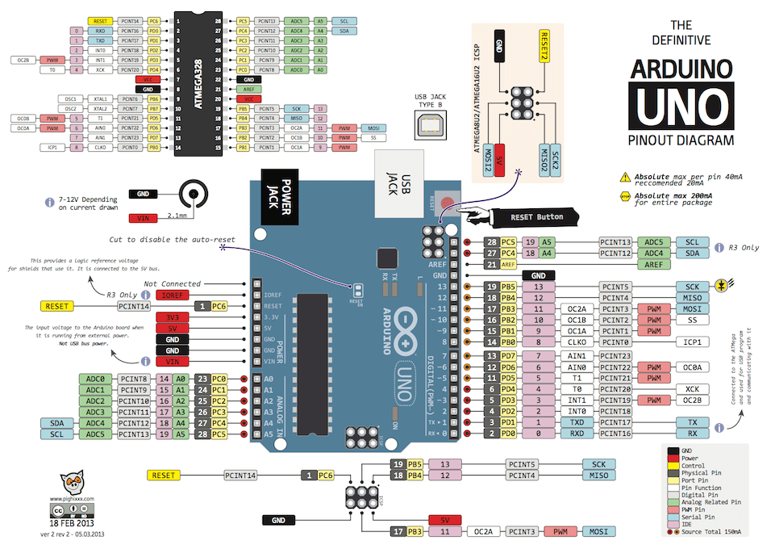

Slide 10

Reset Button
5V Output
Digital Pins
DigitalRead()
DigitalWrite()
AnalogWrite() ~ only
Ground
Battery Input
Analog Input Pins
AnalogRead()
DigitalRead()
DigitalWrite()

Slide 11
Inputs vs Outputs
Referenced from the perspective of the Arduino
Input is a signal / information going into the board. | Output is any signal exiting the board.
Examples: Buttons Switches, Light Sensors, Flex Sensors, Humidity Sensors, Temperature Sensors, … | Examples: LEDs, DC motor, servo motor, a piezo buzzer, relay, an RGB LED, …

Slide 12
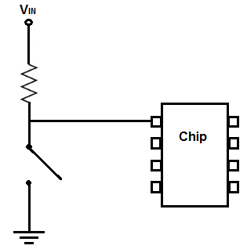
pinMode()
pinMode(pin, mode) configures the specified pin to behave either as an input or an output
  Modes: INPUT, OUTPUT, or INPUT_PULLUP
  Why INPUT_PULLUP?
INPUT_PULLUP

Slide 13
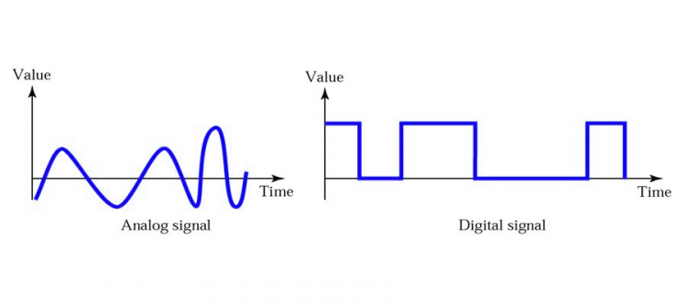
Digital vs Analog

Slide 14
Digital Input: value = digitalRead(pin)
value = digitalRead(3);
  value is 0, if input <= 1.5 V
  value is 1, if input >= 3.0 V
  Value is not determined, if input 1.5 < input < 3.0

Slide 15
Analog Input: value = analogRead(pin)
value = analogRead(A0);
Converts analog input to digital signal with a 10 bits converter:
Input voltage | Analog to digital conversion | value (read in analogRead function)
0V | 0000000000b | 0
5V | 1111111111b | 1023
? | 0000000001b | 1
Notes:
? - > 0.00488

Slide 16
Digital Output: digitalWrite(pin, value)
digitalWrite(3, LOW);
  Output pin will be set to 0V
digitalWrite(3, HIGH);
  Output pin will be set to 5V

Slide 17
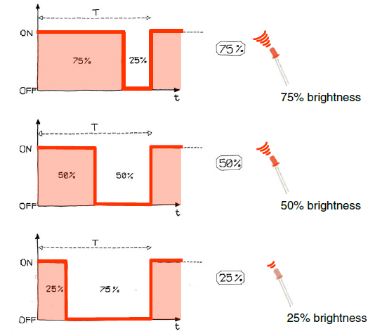
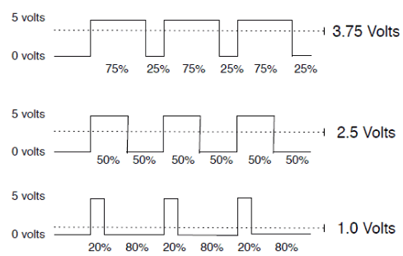
Analog Output: analogWrite(pin, value)
analogWrite(3, 100);
pin limited to pins with the ~ symbol
value can be any number from 0 to 255
0 -> 0V | 255 -> 5V | 128 -> ?
Fixed cycle length; constant number of cycles/sec

Slide 18
Arduino Language
Is actually C language with extra functions ready to be used with any Arduino board
Reference
Open source

Slide 19
setup() and loop() functions
setup(): This function is called once when a sketch starts after power-up or reset. It is used to initialize variables, input and output pin modes, and other libraries needed in the sketch
loop(): After setup() has been called, function loop() is executed repeatedly in the main program. It controls the board until the board is powered off or is reset.

Slide 20
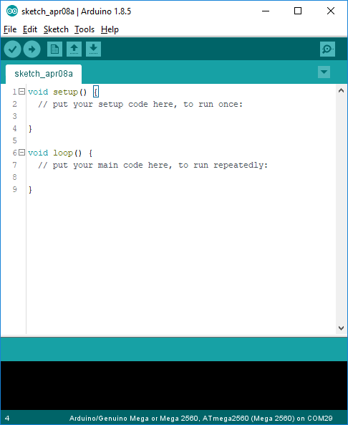
Arduino IDE
See: http://arduino.cc/en/Guide/Environment for more information

Slide 21
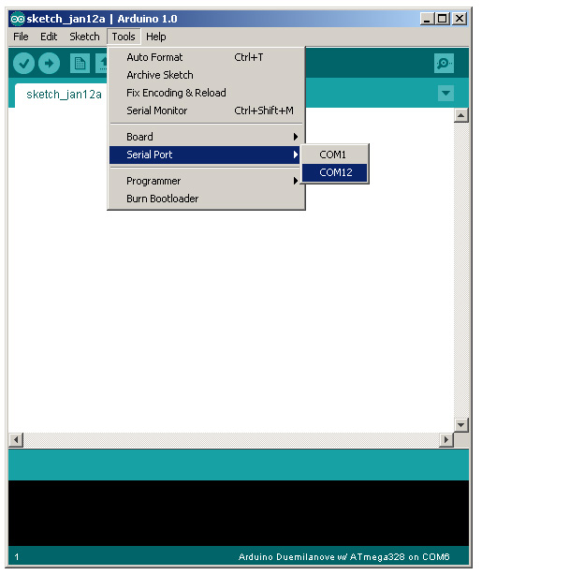
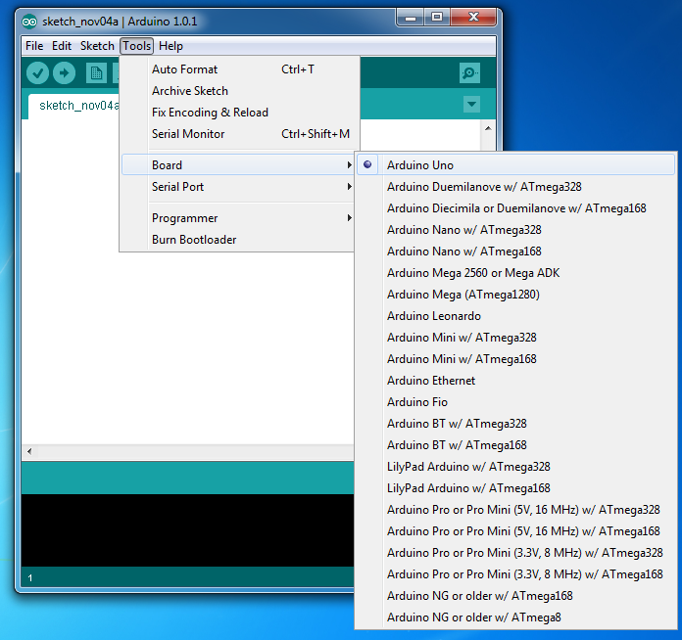
ALWAYS: Select Serial Port and Board

Slide 22
Serial communication
Used for communication between the Arduino board and a computer or other devices
Arduino’s library is ready to use, and you should use it for debugging purposes as well
Serial functions:
  begin()
  print()
  println()
  available()
Note that using serial communication slows down the execution of your code, so your robot may behave differently when you have serial communication on versus not.
  One solution is to save data into an array, then dump it at the end to the serial port. This is what several of the labs do.
  However, the on-board memory on the Arduino is limited, so you can’t save a lot of data with this method.

